Slide 1
Design
EPFL Software Engineering

Slide 2

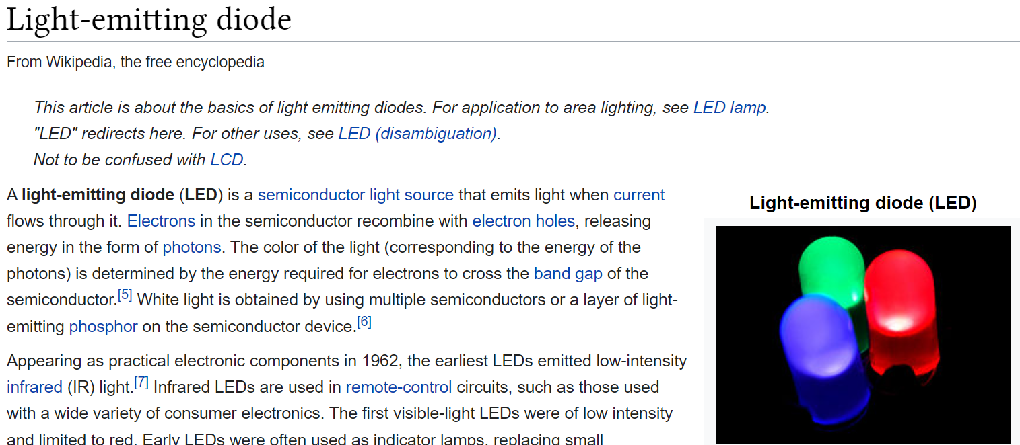
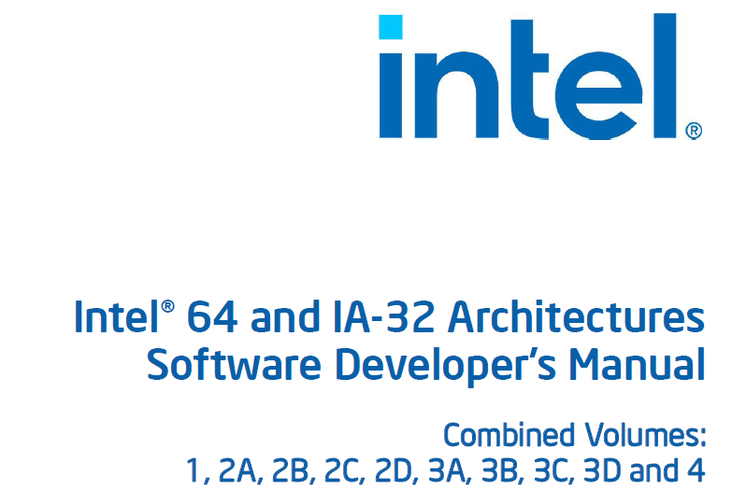
Hello, World!
Page 1 of 4834

Slide 3
Hello, World!
print("Hello, World!")

Slide 4



print("Hello, World!")

Slide 5
Tokenizer
Parser
Interpreter

Slide 6
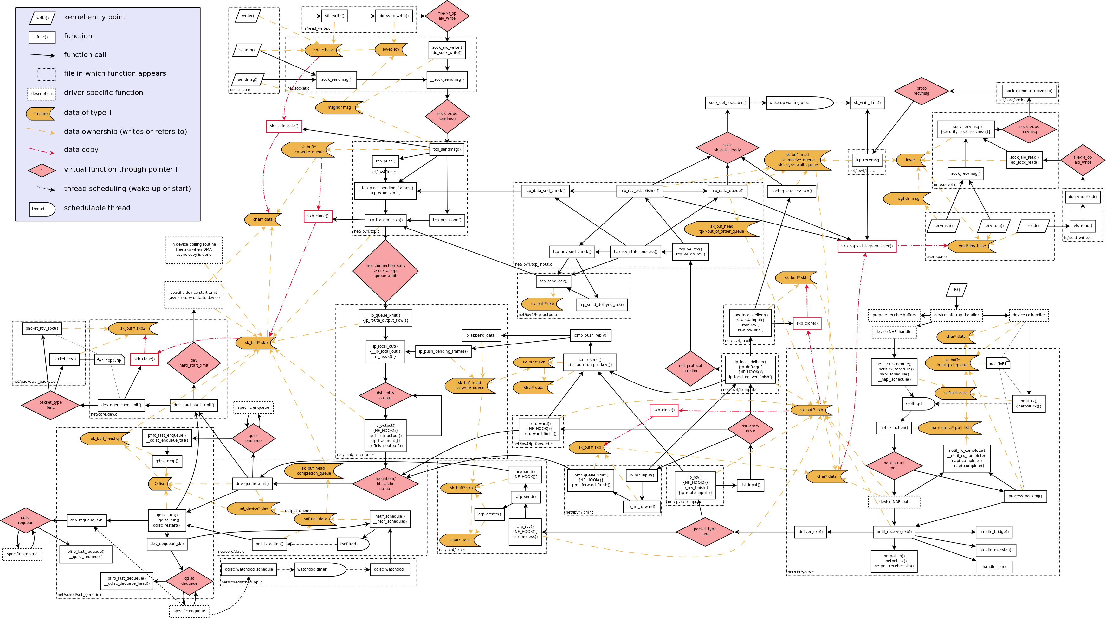
http://web.archive.org/web/20170905131225/https://wiki.linuxfoundation.org/images/1/1c/Network_data_flow_through_kernel.png

Slide 7
Objectives
Apply modularity and abstraction in practice
Compare ways to mitigate defects
Organize code with design patterns
Decouple UI, core logic, and reusable strategies

Slide 8
How can one design large software systems?

Slide 9
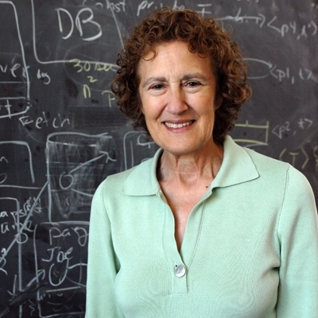
“The basic technique we have for managing the complexity of software is modularity”
Barbara Liskov
150th interview with Dr. Barbara Liskov https://infinite.mit.edu/video/barbara-liskov (Photo: Donna Coveney)

Slide 11
Module
Independent unit,
separately maintained,
reusable in other systems

Slide 12
Interface
What is exposed to the rest of the system
“an abstraction”

Slide 13
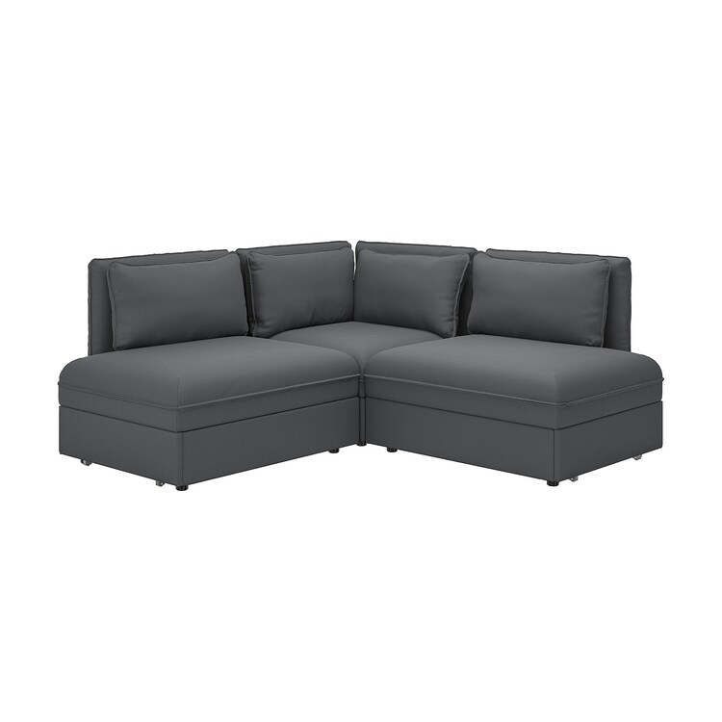


Slide 14
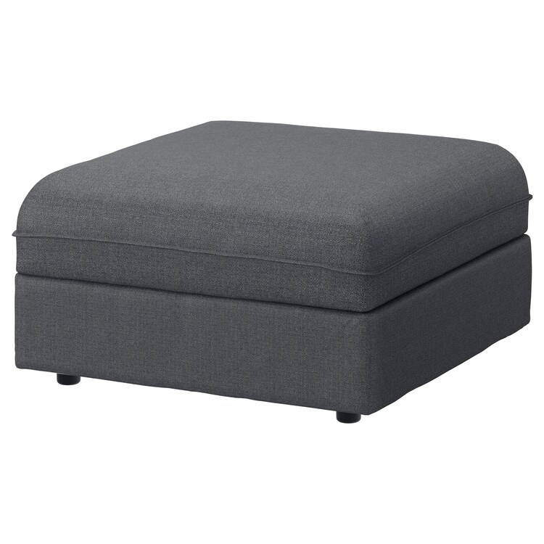
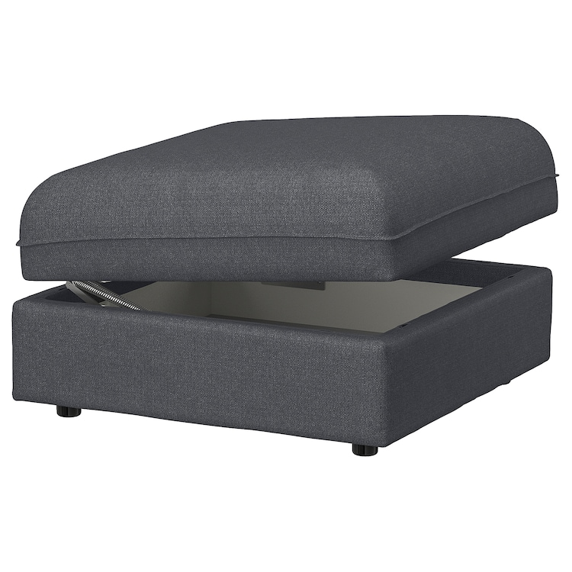
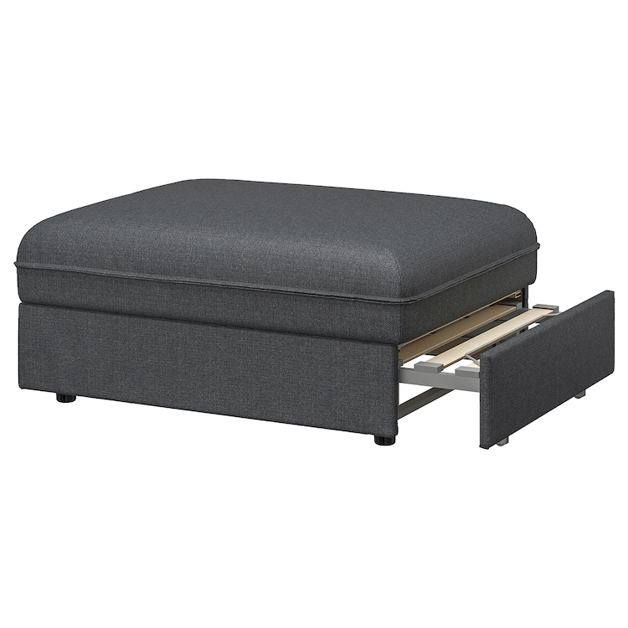

Slide 15
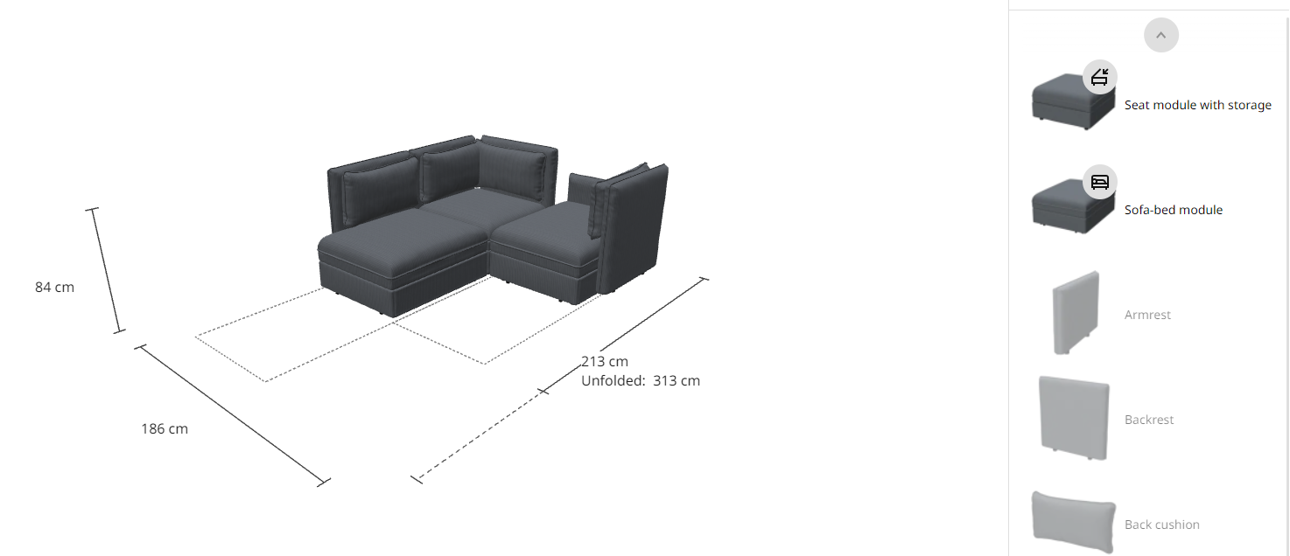

Slide 16
“API”
Application Programming Interface
Objects, functions, errors, …

Slide 17
“Interface” vs “interface”
Theoretical concept
vs. language concept

Slide 18
Example
static int compute(String expr) {
...
}

Slide 19
[uuid(a03d1424-b1ec-11d0-8c3a-00c04fc31d2f)]
interface ICalculator : IDispatch {
HRESULT Compute([in] BSTR expr, [out] long* result);
};
...

Slide 20
@Get("/api/v1/calc")
String compute(@Body String expr) {
...
}

Slide 21
HTTP /api/v1/calc
COM ICalculator
Java compute
21

Slide 22
Ties
class User {
String name;
String favoriteFood;
boolean fetchedFromDatabase;
}

Slide 23
package ch.epfl.sweng.calc;
class User { ... }
class Calculator { ... }
class UserInterfaceCheckbox { ... }

Slide 24
Implicit ties
static int compute(String expr);
class ComputeOptions {
static boolean usePostfixNotation;
}

Slide 25
What would Student look like…
… in a “campus companion” app?
… in a course management system?
… in an authentication system?

Slide 26
What does modularity require in practice?

Slide 28
Abstraction
level
Regularity
Grouping
Layering

Slide 29
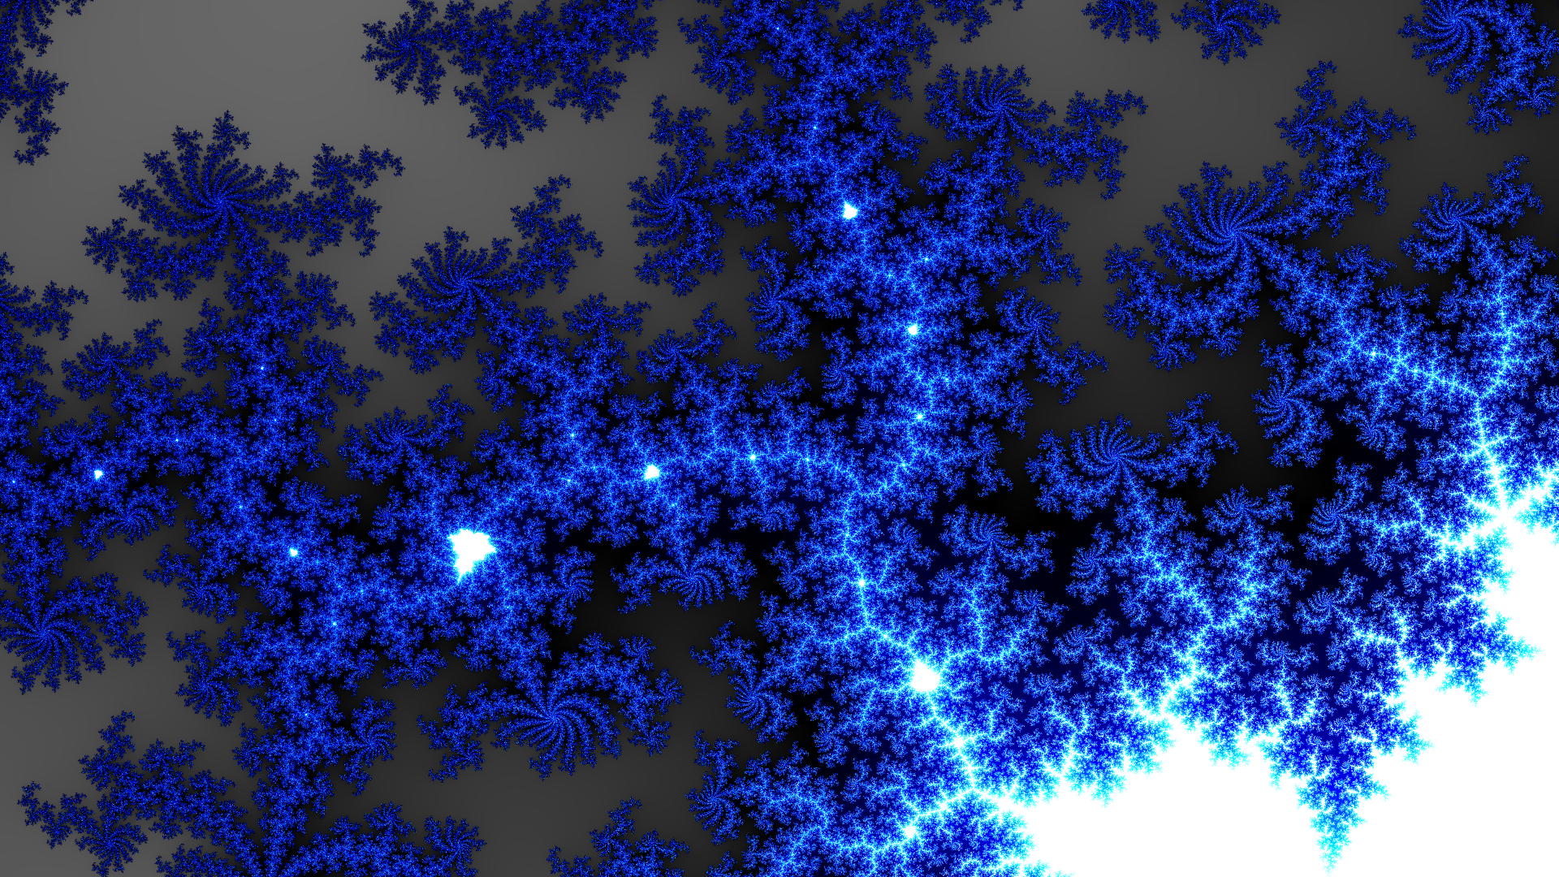
Regularity

Slide 30


Slide 31
Bad example
class Stack {
/** Returns the 1-based position where an object is on this stack. */
int search(Object o);
}
https://docs.oracle.com/en/java/javase/17/docs/api/java.base/java/util/Stack.html#search(java.lang.Object)

Slide 32
“Principle of least surprise”
class URL {
boolean equals(Object obj);
}

Slide 33
Kolmogorov complexity
How many words are needed to describe something?

Slide 34
Grouping
Map<K, V> Base64
Calendar Formatter
Optional<T> Scanner
Timer Date
package java.util;

Slide 35
Container KeysView
Iterable Sequence
Collection MutableSet
Set AsyncIterator
collections.abc (Python)

Slide 36
Global variables

Slide 37
Layering
Application
Transport
Network
Link
Physical

Slide 38
App
Mobile
Server
...
Auth.
HTTP
Network

Slide 39
Layering
Layer N depends only on layer N-1
Implementation context of N = interface of N-1

Slide 40
“Reverse” dependencies
def sort(items) = {
...
if (items(i) < items(j))
...
}

Slide 41
App
sort

Slide 42
Composition
def sort(items, less_than) = {
...
if (less_than(items(i), items(j)))
...
}

Slide 43
App
sort

Slide 44
Composing objects
class HttpClient:
def __init__(self):
self.socket = Socket(...)

Slide 45
class HttpClient:
def __init__(self, socket):
self.socket = socket

Slide 46
Composing modules
generic
type Socket is private;
package Http_Client is
...
end Http_Client;
Ada programming language

Slide 47
Inheritance vs. composition
class MyApp extends MobileApp
class MyApp { private MobileApp mobile; }

Slide 48
MobileApp
MyApp
MyApp
MobileApp

Slide 49
Inheritance in same layer
LaserPrinter
Printer
InkjetPrinter

Slide 50
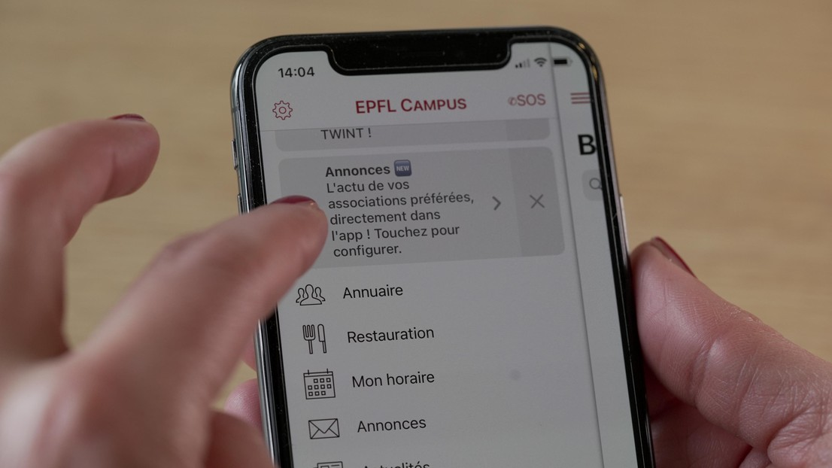
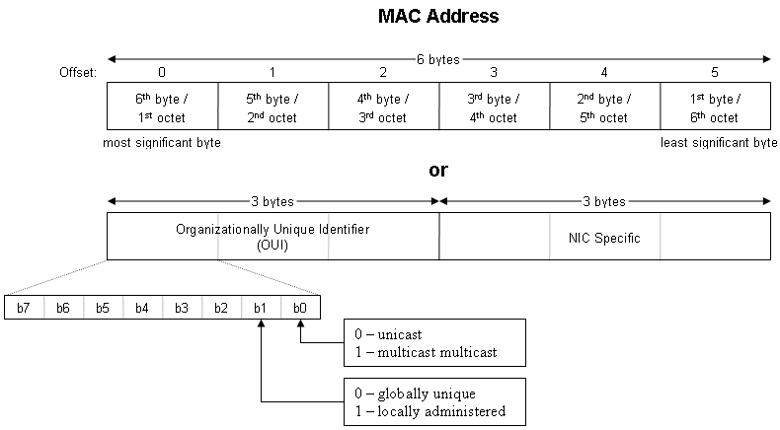
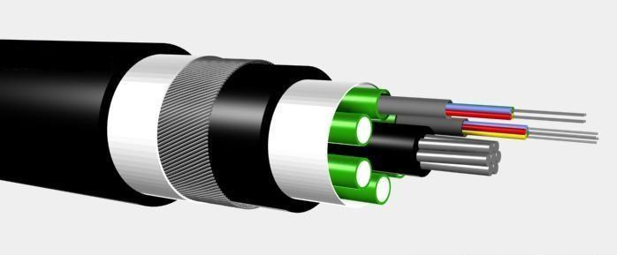
Abstraction levels
Wikipedia (Optical fiber cable, MAC address), EPFL News (EPFL Campus)

Slide 51
Abstraction levels
Impossible to use
Desired
Annoying to use

Slide 52
You can expose >1
package net.fiber;
package net.ethernet;
package net.app;

Slide 53
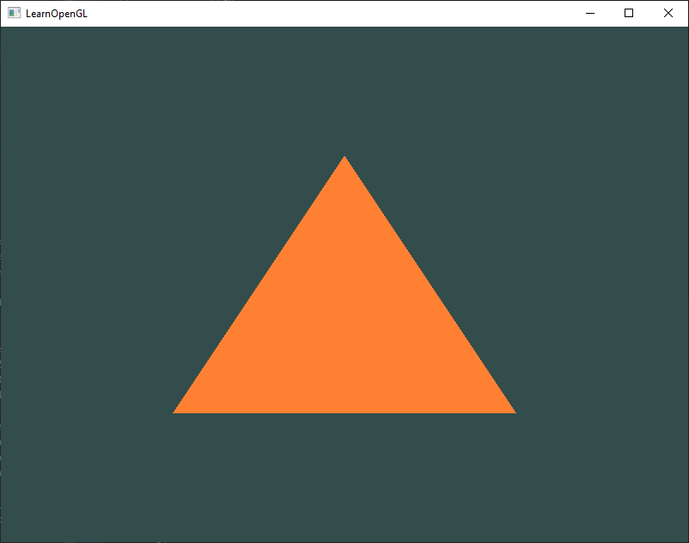
Example
GDI: 10 lines
OpenGL: 100 lines
Vulkan: 1000 lines

Slide 54
Beware of abstraction “leaks”
void showMenu(LocalDate date, boolean useIPv4);

Slide 55
/** Reads a line and puts it into str */
char* gets(char* str);

Slide 56
Abstraction leak

Slide 57
abstraction leak ≠ security leak

Slide 58
1 abstraction
1 abstraction level

Slide 59
int predictWeather(LocalDate date) {
var past = getPastWeather(date);
var temps = extractTemperatures(past);
return predict(temps);
}

Slide 60
Example
Win32
App
Windows kernel
OS/2
App
POSIX
App

Slide 61

Windows kernel
Win32
App
Virtual machine
Linux kernel
App

Slide 62
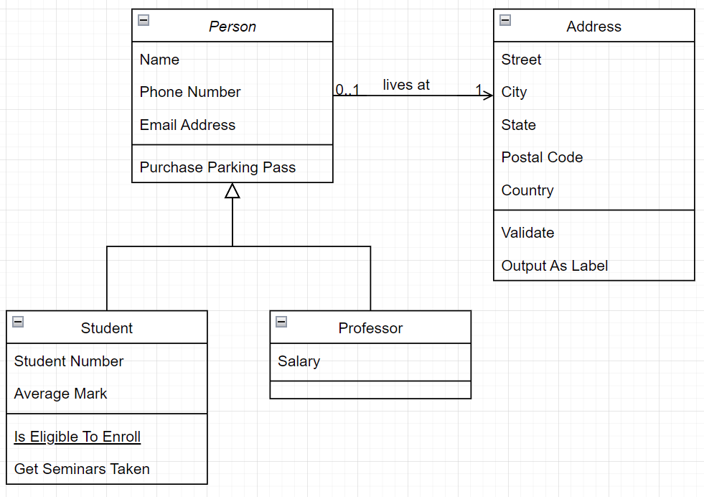
Discussing modularity

Slide 63
Diagram goal
Discussion: “is this reasonable?”
Not a specific notation

Slide 64
Exercise
Modularize App.java in calc/
First step: what will the main method look like?
Notes:
15min

Slide 65
New main method
while (true) {
var text = getInput();
if (text == null) { break; }
var tokens = parseInput(text);
var result = compute(tokens);
display(result);
}

Slide 66
Integer execute(String op, int a, int b) {
switch (op) {
case "+":
return a + b;
// ...
}
}

Slide 67
How far to go?

Slide 68
Estimating size

Slide 69
Estimating complexity
def doRunRunRunDaDoRunRun(
dispatch: DispatchReporter, suitesList: List[SuiteParam], agains: List[String], testSpecs: List[TestSpec], junitsList: List[String], stopper: Stopper, tagsToIncludeSet: Set[String], tagsToExcludeSet: Set[String], configMap: ConfigMap, concurrent: Boolean, membersOnlyList: List[String], wildcardList: List[String], testNGList: List[String], runpath: List[String], loader: ClassLoader, doneListener: RunDoneListener, runStamp: Int, concurrentConfig: ConcurrentConfig, suffixes: Option[Pattern], chosenStyleSet: Set[String], testSortingReporterTimeout: Span
): Unit
org.scalatest.tools.Runner

Slide 70
“You Aren’t Gonna Need It”
= “YAGNI”
Design for actual needs, not possible needs

Slide 71

Beware of “cargo cults”
John Frum cross (Wikipedia)

Slide 72
How can one mitigate the impact of defects?

Slide 73

?

Slide 74
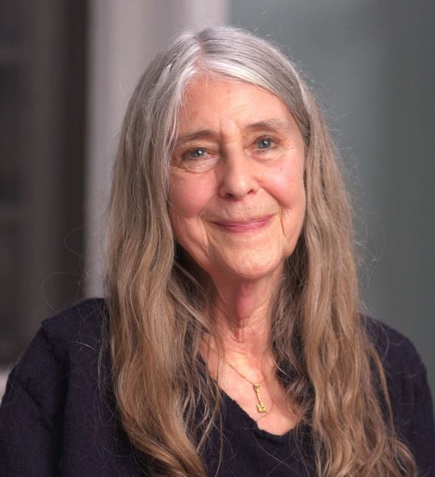
“[The managers] said ‘this won’t ever happen, astronauts are well-trained, they don’t make mistakes’ …
The Language as a Software Engineer, ICSE 2018 keynote (photo: still from a MAKERS interview)

Slide 75
… the very next mission, Apollo 8, this very thing happened […] it took hours to get [data] back”
Margaret Hamilton

Slide 76



Terminology
Error
Defect (bug)
Failure

Slide 77



Errors

Slide 78
Can’t prevent errors
Humans make mistakes

Slide 79
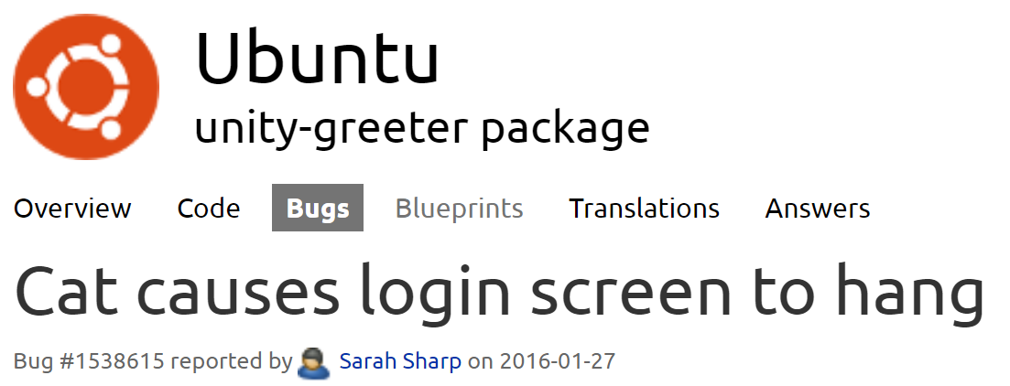
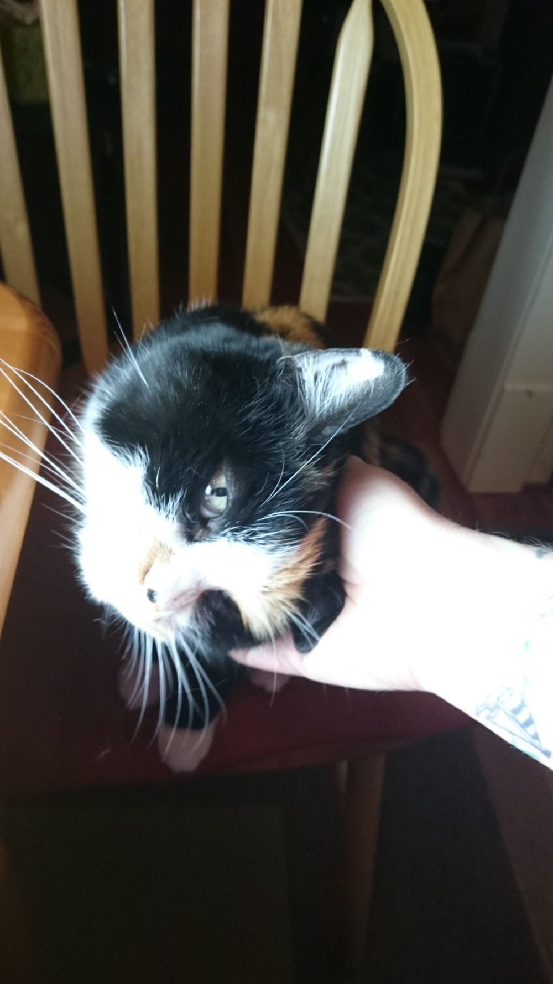
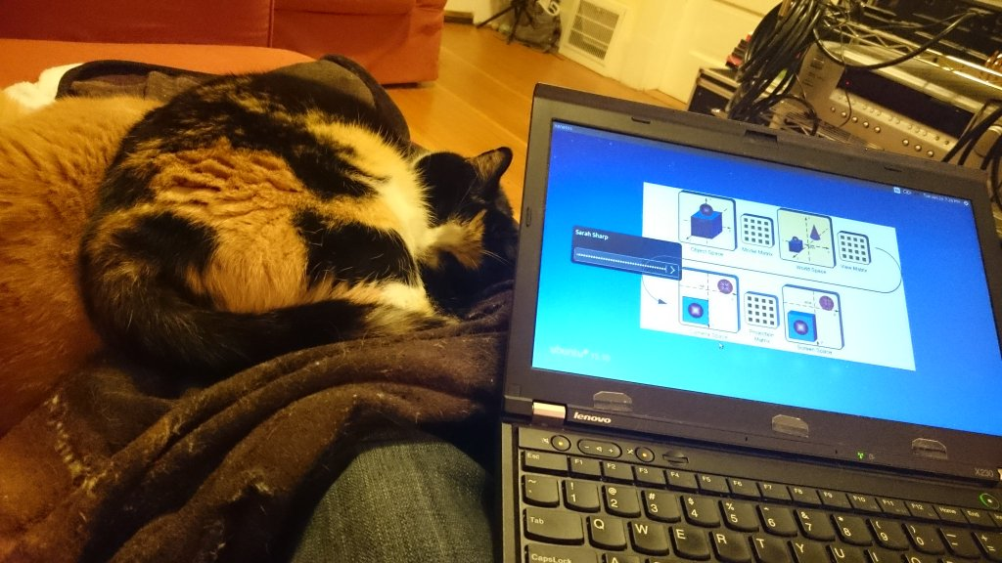
https://bugs.launchpad.net/ubuntu/+source/unity-greeter/+bug/1538615

Slide 80
Defect
Failure

Slide 81
Mitigating defects
Isolate
Repair
Retry
Replace

Slide 82
Isolate

Slide 83
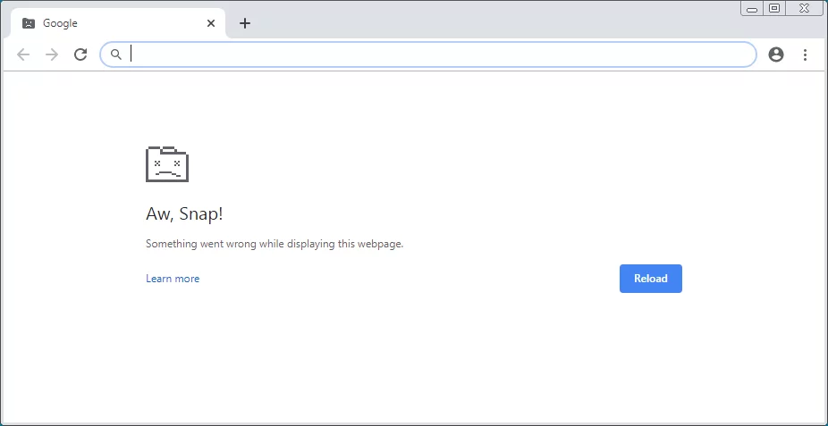

Slide 84
Isolate if…
Module instance isn’t strictly necessary

Slide 85
Repair
?

Slide 86
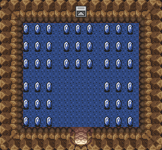
https://zelda-archive.fandom.com/wiki/Top_Secret_Room

Slide 87
Coarse repair
“Have you tried turning it off and on again?”

Slide 88
Repair if…
There exists a known good state

Slide 89

Retry

Slide 90
while retries < 5:
...

Slide 91
But…
account.withdraw(100)

Slide 92
Retry if…
Operation is idempotent
Problem is recoverable

Slide 93
Recoverable problems
No Internet
Printer starting up
…
≈ Java “checked” exceptions

Slide 94
Unrecoverable problems
Username is already taken
Server is overloaded
Division by zero
…
≈ Java “unchecked” exceptions

Slide 95







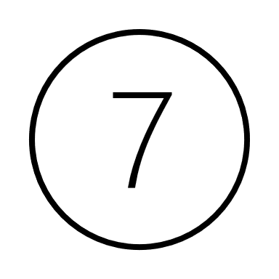


Replace
0

Slide 96
Replace if…
There is a tested alternative

Slide 97
How much to tolerate?
What’s at stake?

Slide 98

Thames barrier
4 motors per gate
2 service tunnels
3 connections to electrical grid
3 backup generators
+ frequent tests
Tom Scott, “The Thames Barrier must never fail”, YouTube

Slide 99
How can one reuse concepts across software systems?

Slide 100

Problem

Slide 101
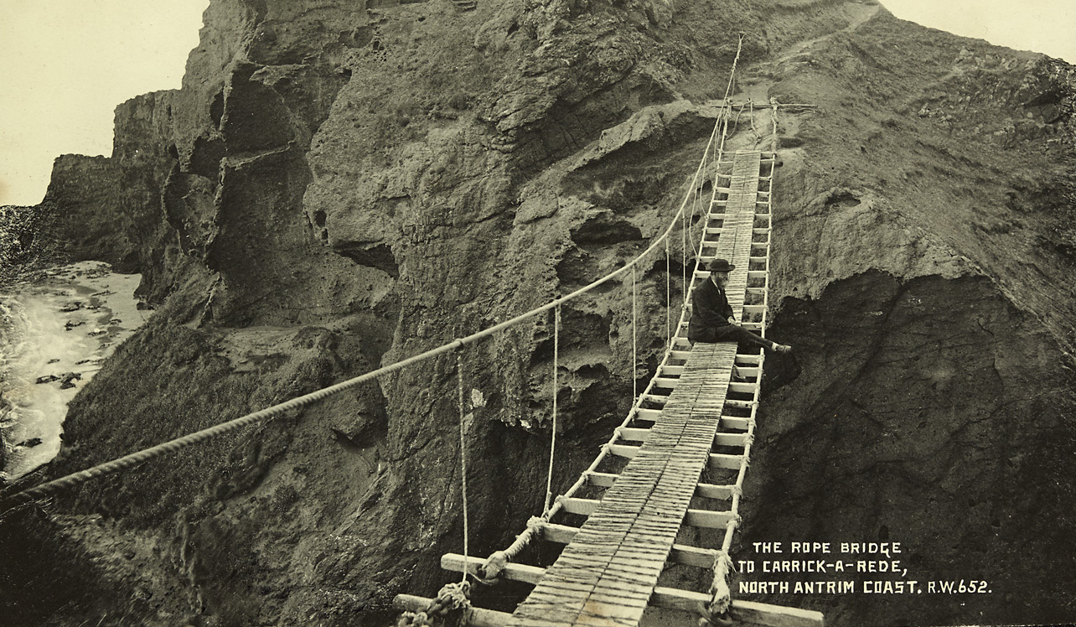
Custom solution?

Slide 102
Terminology
“A way to join two points separated by
a ravine, a river, etc. so that humans or
vehicles could cross. One needs pillars
bound together with ropes to spread the
load, and the size of the pillars and ropes
is determined by …

Slide 103
“A bridge”

Slide 104
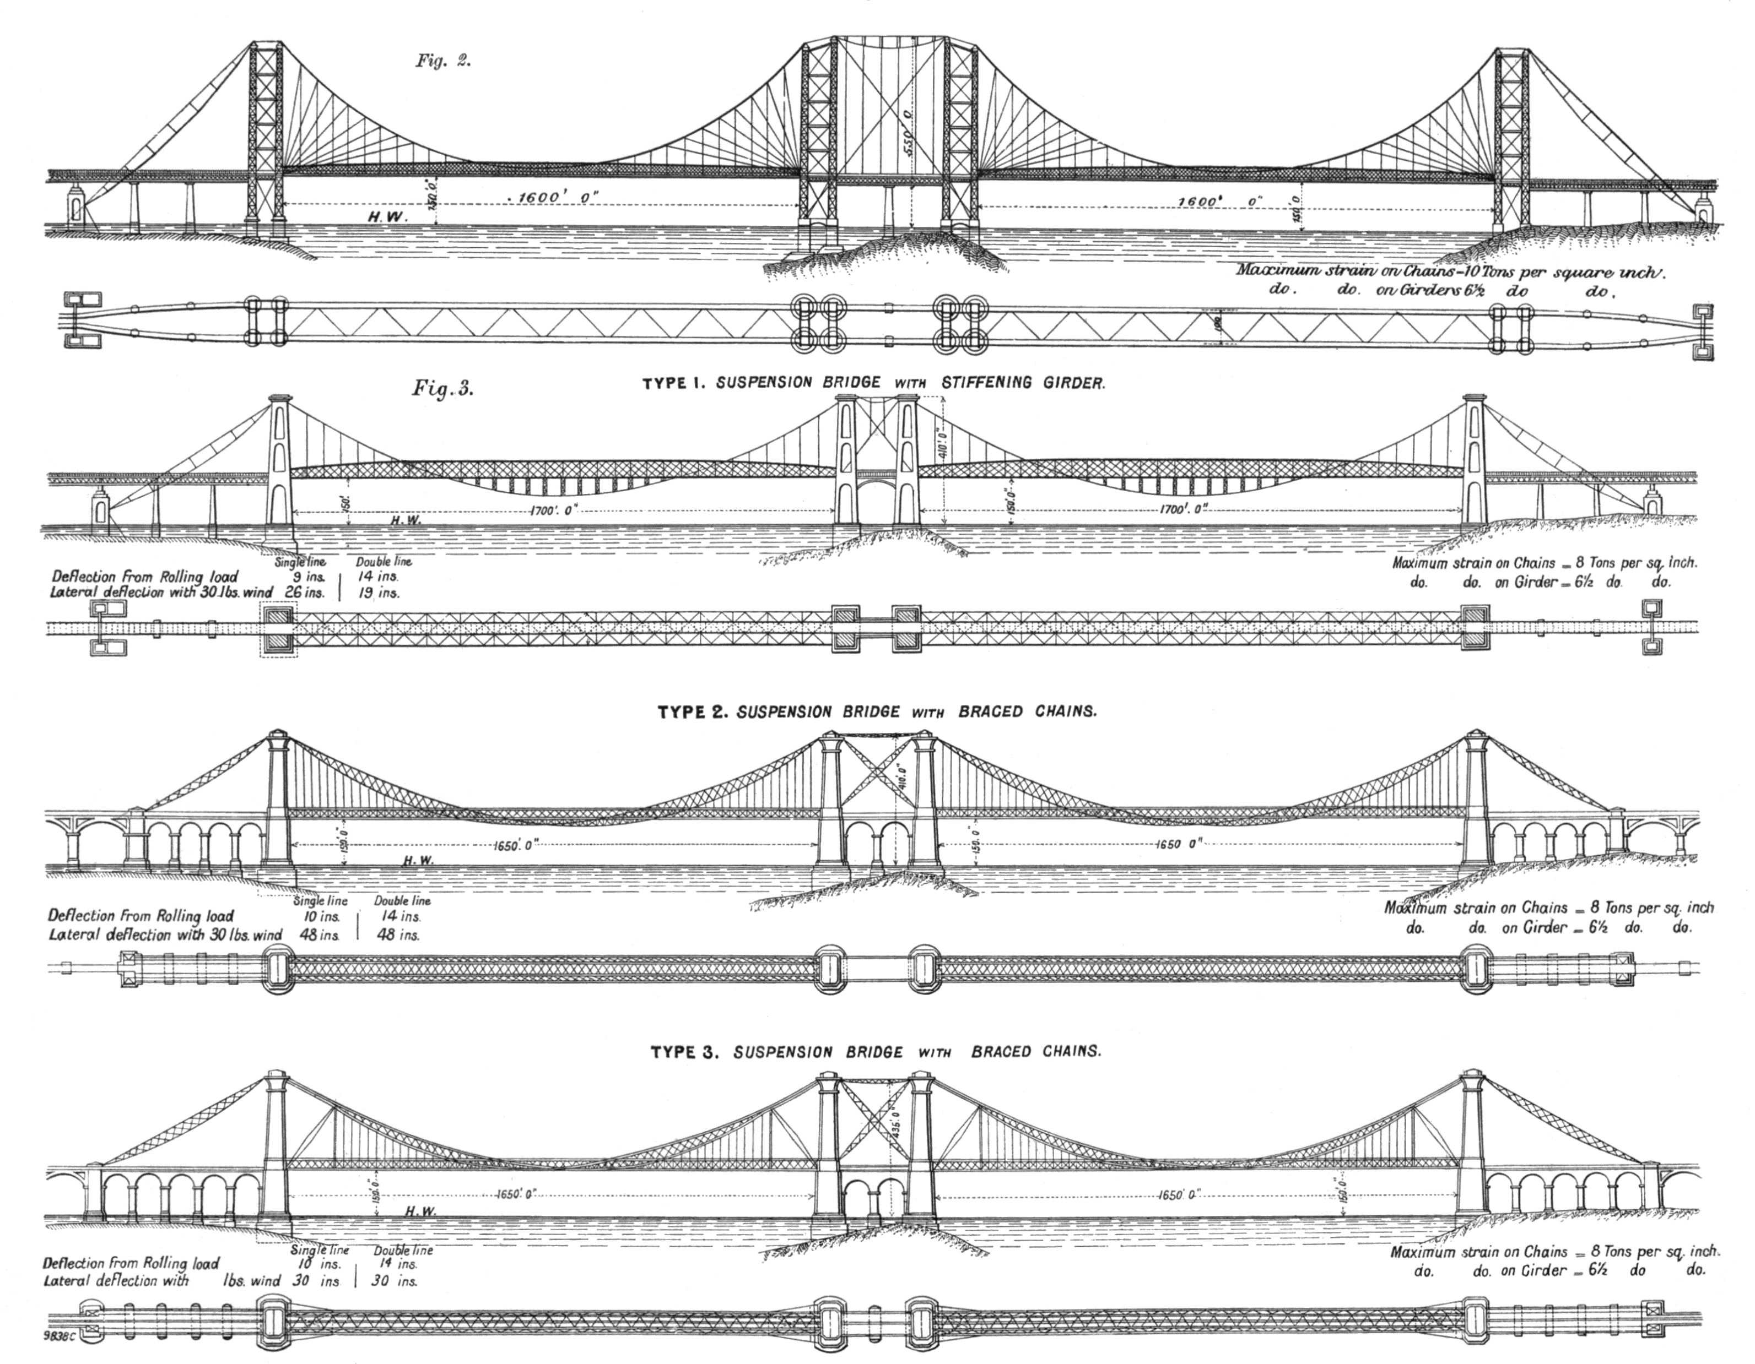
Solution blueprints

Slide 105
Terminology
“A function that returns a subclass, depending on its arguments, which isn’t feasible with a constructor”

Slide 106
“A factory”

Slide 107
“Design patterns”
Software engineer vocabulary

Slide 108
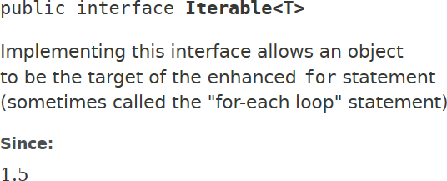
Some have become implicit
for (int item : items) {
// ...
}

Slide 109


Blueprint, not algorithm

Slide 110
Examples
Adapter
Builder
Composite
Observer
…more in the written summary

Slide 111
Today’s patterns
Separating the user interface,
the business logic,
and the reusable strategies

Slide 112


Desktop app
Mobile app

Slide 113
UI
UI
Logic
Tests

Slide 114
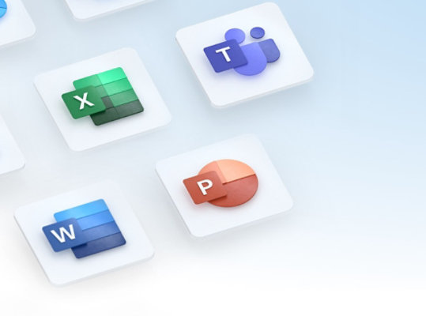

Slide 115
Decouple UI and logic
View
Model
???

Slide 116

Model-View-Controller (MVC)
input
Controller
Model
View
creates

Slide 117
MVC disadvantages
Users must interact with the Controller
Views created “from scratch”

Slide 118
Model-View-Presenter (MVP)
View handles user input

Slide 119

Model-View-Presenter (MVP)
X
Presenter
def sayHi(name) = {
"Hi " + name + "!" }
Say hi
Hi X!

Slide 120
Presenter
"YO " + name + "!!!"

Slide 121

Presenter
Mock

Slide 122
Exercise
Transform the code of weather/ to use MVP
First step: what interfaces for the Model and View?
Notes:
4min til next

Slide 123
Possible interfaces
interface Model { String getForecast(); }
interface View { void show(String text); void run(Presenter presenter); }
Notes:
Now do the Model, just moving code, and the View; 4min til next

Slide 124
View
class ConsoleView implements View {
private final Scanner scanner = new Scanner(System.in);
}
Notes:
Next

Slide 125
public void show(String text) {
System.out.println(text);
}
Notes:
Next

Slide 126
public void run(Presenter presenter) {
while (true) {
scanner.nextLine();
presenter.onInput();
}
}
Notes:
Now what will the presenter look like? 4min

Slide 127
Presenter
class Presenter {
private final Model model;
private final View view;
Presenter(Model model, View view) { ... }
}

Slide 128
public void onInput() {
view.show("Weather forecast: " + model.getForecast());
}

Slide 129
public void run() {
view.show("Hi! ...");
view.run(this);
}

Slide 130
MVP disadvantages
View holds state
View interface can get messy, tied to UI framework

Slide 131
What’s an UI?
Data
Commands

Slide 132
Idea
View can observe data changes

Slide 133
Model-View-ViewModel (MVVM)
View
observes
ViewModel
uses
Model

Slide 134
ViewModel
Platform-independent UI:
Data, Data change events, Commands

Slide 135
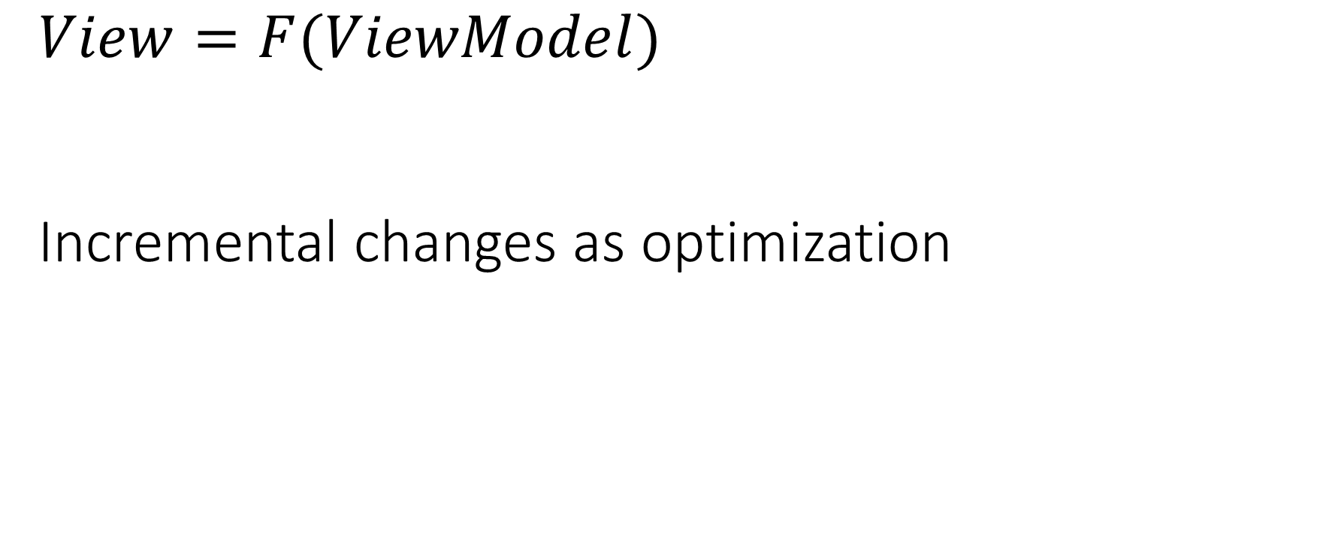
View in MVVM
$$View=F(ViewModel)$$
Incremental changes as optimization

Slide 136
MVVM
VM
X
def sayHi(name) =
...
Say hi
Hi X!
Hi X!

Slide 137
MVVM code reuse
DesktopView
MobileView
ViewModel
Model

Slide 138
MVVM disadvantages
Needs more “support” code
More complex if just 1 view

Slide 139
“Can the weather be cached?”
“…and if the server is down, retry?”
“…and …”

Slide 140
Where?

Slide 141
Layers!
Caching
Retry

Slide 142
Middleware, a.k.a. Decorator
Layer with same interface
Can “short circuit”

Slide 143
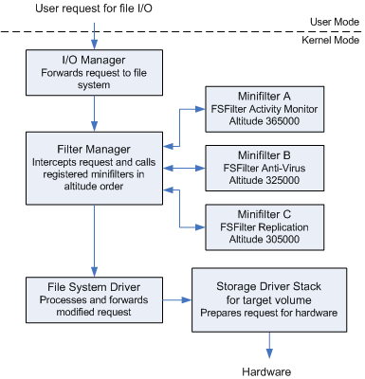



https://learn.microsoft.com/en-us/windows-hardware/drivers/ifs/filter-manager-concepts

Slide 144
Exercise
Add retrying to your weather/ code, if the forecast is “???”
First step: Define a Model that wraps another Model
Notes:
3min til next

Slide 145
Interface
interface Model {
String getForecast();
}
Notes:
Next

Slide 146
Middleware
class RetryingModel implements Model {
private final Model wrapped;
RetryingModel(Model wrapped) { ... }
}
Notes:
Now make it retry; 4min

Slide 147
public String getForecast() {
String result;
do {
result = wrapped.getForecast();
} while (result.equals("???"));
return result; }

Slide 148
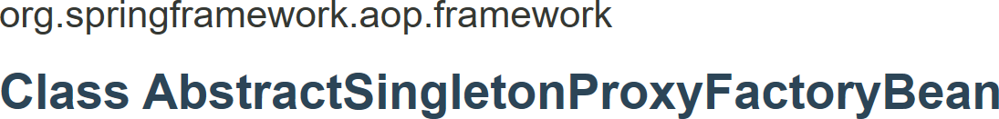
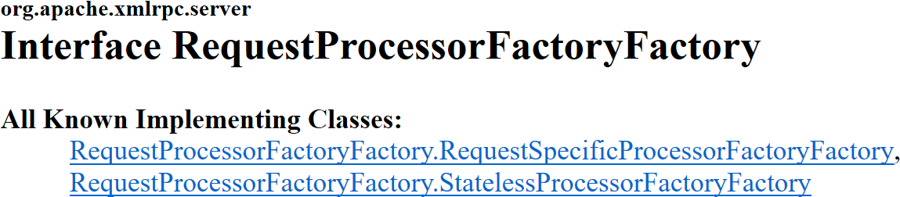
“You Aren’t Gonna Need It”

Slide 149
Summary
Abstraction and modularity: regularity, groups, layers, levels, “leaks”
Tolerating defects: isolating, retrying, repairing, replacing
Design patterns: MVC, MVP, MVVM, Middleware

